Slide 1

GCSE English Language Creative Writing
L3: Describing Place (AO5)

Slide 2

Learning Objective
To write a clear, effective and imaginative description of a scene.
Success Criteria
To create sensory imagery.
To explore moving from general to particular detail.
To identify and then apply ways to upgrade descriptive writing.

Slide 3
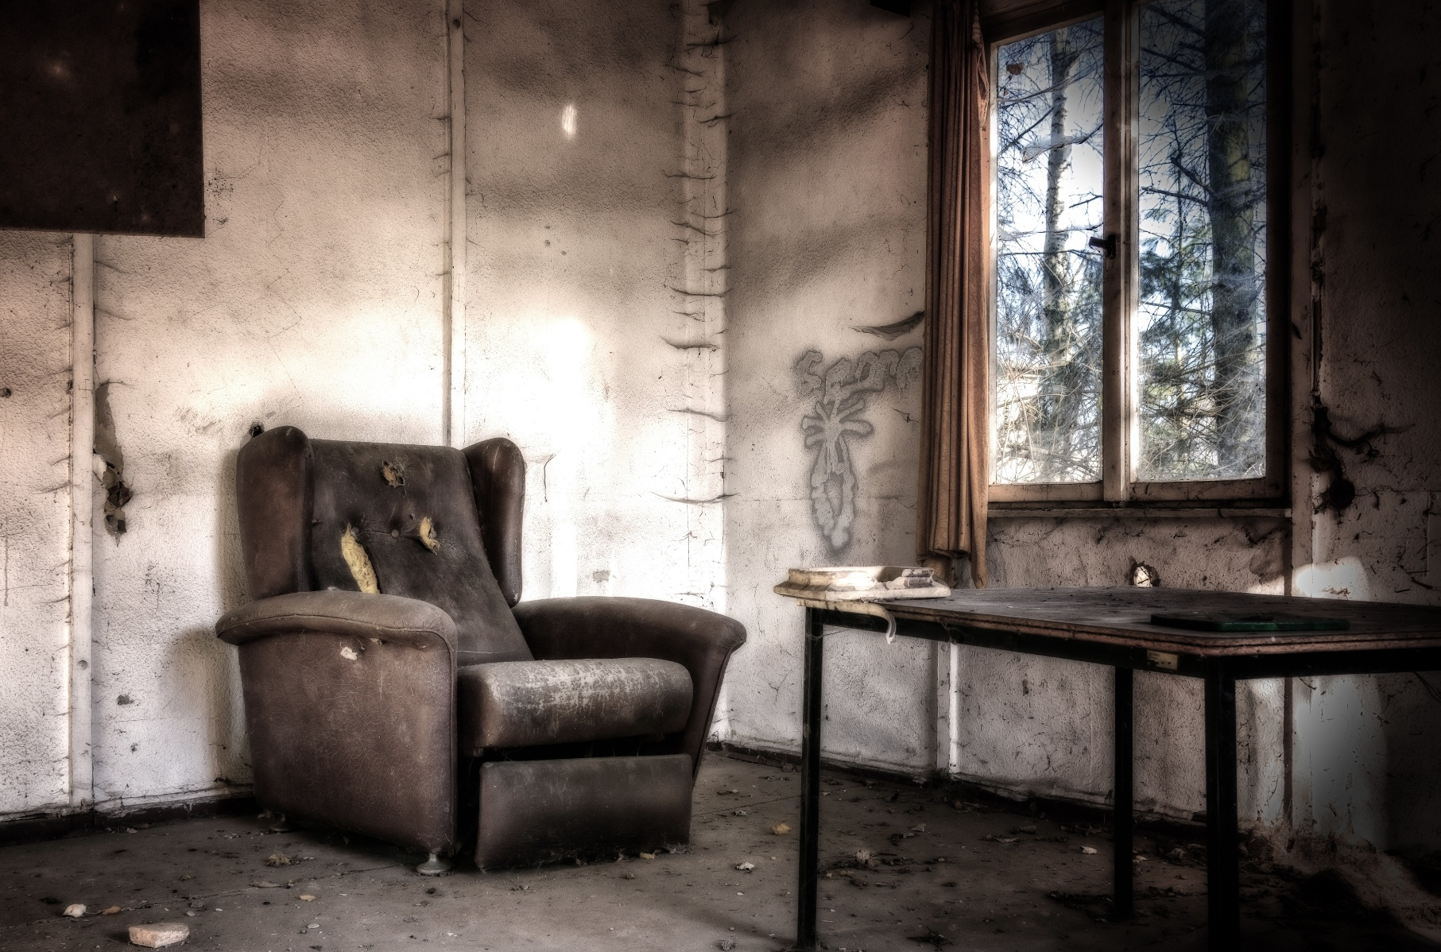
What’s the Story?
Look carefully at this scene and use your imagination to answer the questions.
Where is
this?
How did you get here?
How do you feel in this room?
Is there anyone else in the room?
Now, share your ideas with your partner. Did you both come up
with similar ideas, or are they very different?

Slide 4
Creative Writing
Remember, your GCSE English Language exam will require you to write a piece of narrative and/or description, assessed using AO5 and AO6. This lesson, we’ll be looking at the highlighted aspect of AO5:
GCSE English Language AO5:
Communicate clearly, effectively and imaginatively, selecting and adapting tone, style and register for different forms, purposes
and audiences. Organise information and ideas, using structural
and grammatical features to support coherence and cohesion of texts.
GCSE English Language AO6:
Use a range of vocabulary and sentence structures for clarity, purpose and effect, with accurate spelling and punctuation.

Slide 5

Sensory Description
When you’re creating a story or piece of descriptive writing, it’s important to think carefully about the environment you’re setting it in, so that your reader can be transported to the place you’ve created.
This lesson, we’ll look at how to clearly, effectively and imaginatively create a sense of place through description.
A great way to start is to think of the five senses and use them to build your description. Let’s return to the room from the starter.
What can you SEE?
What can you HEAR?
What can you SMELL?
What can you TASTE?
What can you FEEL?

Slide 6

Zooming In
Although sensory description is a great place to start, it can make your writing a little formulaic. One way to avoid this is to move from general description (e.g. of the room) to particular description (e.g. of an object). Imagine you are a camera, zooming in on a particular piece of detail.
Can you identify where this description moves from the general to the particular?
General
detail
The walls were scuffed and crumbling, and the room smelled of damp. The floor had lost its carpet long ago, and dry leaves skittered over the concrete. To the left of the window sat a ruined armchair.
Stuffing gaped out of holes, and insects wove in and out of the filthy grey fabric. A terrible smell rose from it, like something had died there.
Particular
detail
Now you try! Write a paragraph of sensory description of the scene, starting with general impressions then moving onto particular detail.

Slide 7
Paint a Picture with Words
You’ve built up some great descriptive detail, but can you refine it any further? One way to add colour to our writing is to use some literary techniques. Take a look at these examples:
The walls were scuffed and crumbling, and the room smelled of damp. The floor had lost its carpet long ago, and dry leaves skittered over the concrete. To the left of the window sat a ruined armchair. Stuffing gaped out of holes, and insects wove in and out of the filthy grey fabric. A terrible smell rose from it, like something had died there.
The walls were scuffed and crumbling, and the room smelled of damp. The floor had lost its carpet long ago; dry leaves skittered over the concrete like spiders. To the left of the window sat the corpse of an armchair. Stuffing gaped out of holes like open wounds, while insects wove greedily in and out of the filthy grey fabric, as if feasting on long-dead flesh. A terrible smell of death rose from its giant, rotting bulk.
Which do you prefer? Can you explain why?

Slide 8
Paint a Picture with Words
You’ve built up some great descriptive detail, but can you refine it any further? One way to add colour to our writing is to use some literary techniques. Take a look at these examples:
The walls were scuffed and crumbling, and the room smelled of damp. The floor had lost its carpet long ago, and dry leaves skittered over the concrete. To the left of the window sat a ruined armchair. Stuffing gaped out of holes, and insects wove in and out of the filthy grey fabric. A terrible smell rose from it, like something had died there.
The walls were scuffed and crumbling, and the room smelled of damp. The floor had lost its carpet long ago; dry leaves skittered over the concrete like spiders. To the left of the window sat the corpse of an armchair. Stuffing gaped out of holes like open wounds, while insects wove greedily in and out of the filthy grey fabric, as if feasting on long-dead flesh. A terrible smell of death rose from its giant, rotting bulk.
Which do you prefer? Can you explain why?

Slide 9
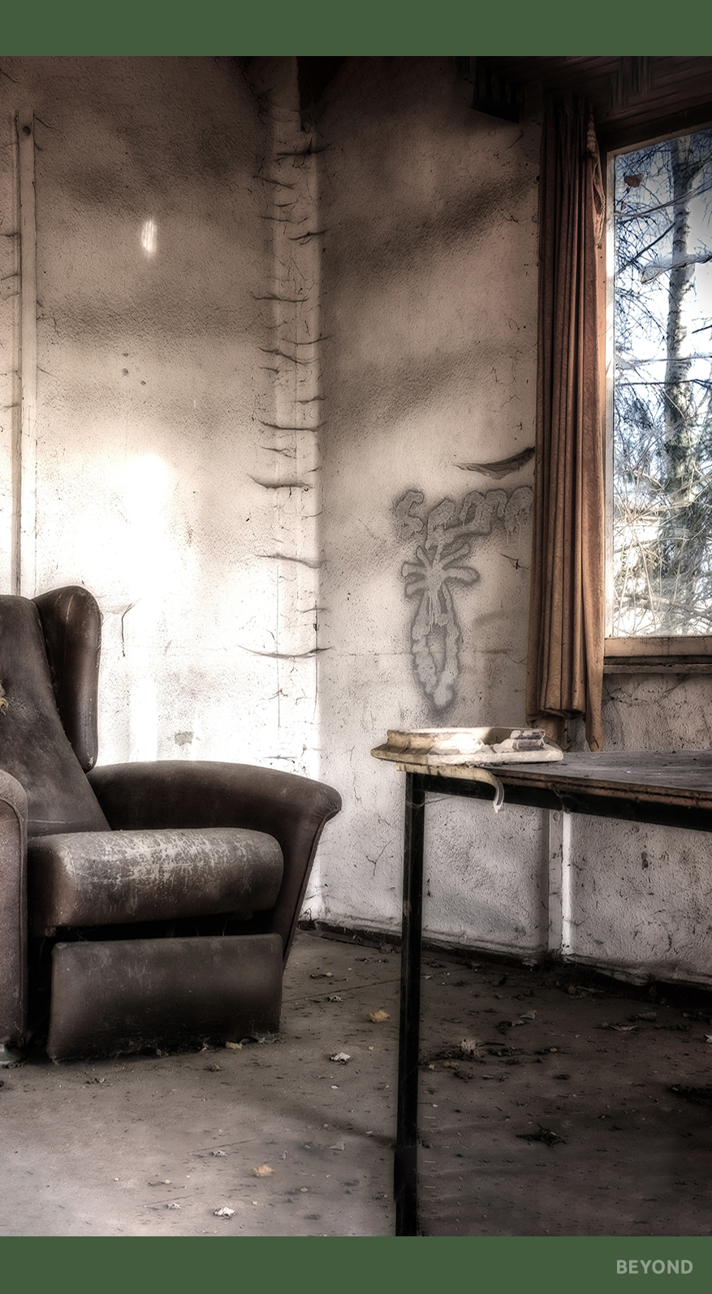
Paint a Picture with Words
Return to the sensory paragraph you wrote earlier. What can you change to make it more effective?
Think about:
similes
metaphors
adjectives
adverbs
alliteration
connectives
punctuation

Slide 10

3-2-1
Write down:
3 things to remember when describing a scene
2 ways you could make your writing more effective
1 phrase you wrote today that you’re proud of

Slide 11


